Slide 1
Impact Alert System
Team:
David Goodman
Sharon Rabinovich

Slide 2
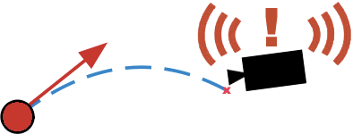
Description
Goal: Detect a ball moving towards the camera, and sound an alarm before the ball hits the camera.
References:
Computer Vision: Algorithms and Applications, by R. Szeliski
Section [8.4] - Optical flow
Monocular distance estimation from optic flow during active landing maneuvers, by F. Breugel et al.
Realtime Depth Estimation and Obstacle Detection from Monocular Video, By A. Wedel et al.

Slide 3

Detailed Description
Algorithm: use optic flow, a dynamical model of the ball, and focus of expansion to detect impact
Real time
Up to 30 frames per second
Object detection and tracking
Background subtraction with optical flow
Trajectory model
Calibration at known distances
Impact prediction
Bounding box
Pixel area threshold
Wikimedia Commons: Skorkmaz
Notes:
Detection and Tracking:
* Assuming ball is only moving object in frame, we can detect the ball with optical flow.
Predict trajectory with dynamic model. Solve in real time.
Difficult: Velocity is not directly observable, but TTC, which is proportional to the enlargment, is observable.
Calibration or system ID. Know: mass, actual diameter*. Calibrate: drag coeffcient, apparent diameter vs distance*.
Impact prediction:
Bounding box. One possible approach, though could have issues due to curved trajectory.
Pixel area threshold.
Only cases with positive slope (vs time) matter.

Slide 4
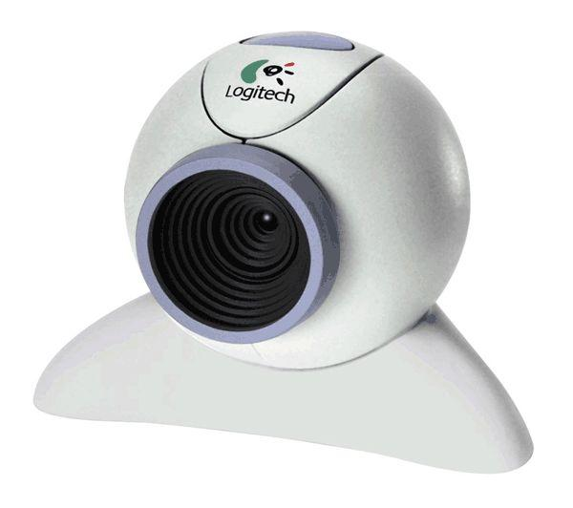
Platform
Software
Matlab/Simulink or OpenCV
Hardware (depends on performance of simulation)
Camera
PC/Mac
Power Supply
Special ball (brightly colored)
From Google.com/images
Notes:
Software:
First step: using MATLAB at development environment for design, analysis, system id, simulation.
MATLAB will run pre-recorded video.
Eventually, move to OpenCV for performance.
Hardware:
Camera. Need to calibrate.
PC for running algorithm (real-time or simulation)
Special ball. Size, color.

Slide 5
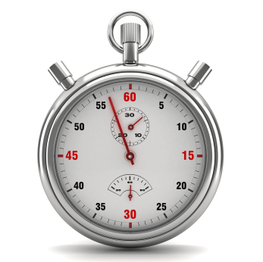

Challenges
Implementation in real time
Alert before impact (distance threshold)
Velocity of projectile
Frame rate of camera
Trajectory prediction
Distance
Velocity
Direction
From Google.com/images
From Google.com/images
Notes:
Real time challenges:
May work in simulation.
But given distance 10 m, v_max = 10 m/s, fps=30, we have only 1 second to decide, ie. 30 frames of information
How soon should alert be sounded before impact? Depends on implementation and result.
Trajectory prediction:
Estimating distance. 3 dimensions into 2 dimensions
Estimating velocity.

Slide 6
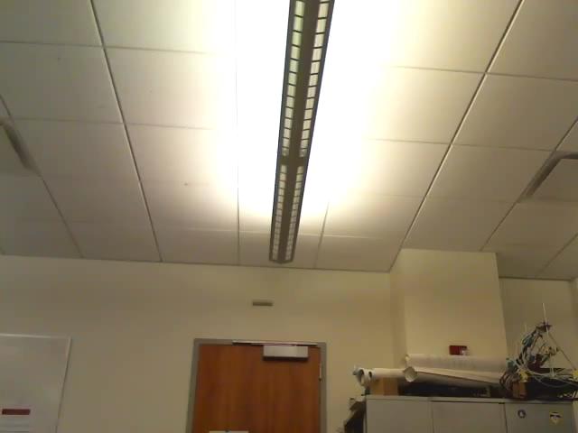
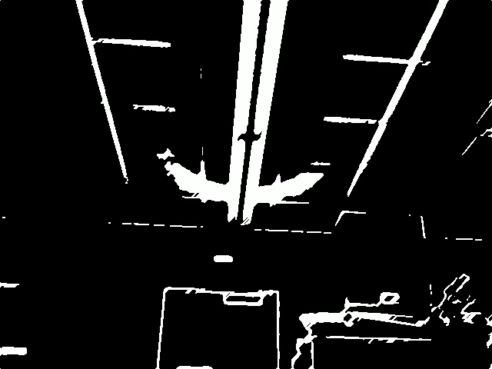
Demo - March 12
Presentation
Demonstration of tested scenarios
Live Demonstration
Audience
Notes:
Compare videos.
Contrast/color between background and object in optical flow.
Trail behind object (fps).

Slide 7
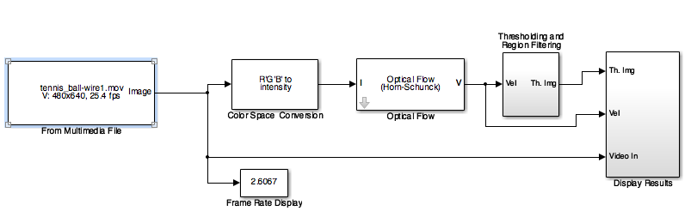
Contingency plans
In case of success
Extension for moving camera with static scene
In case of difficulties
Run algorithm offline
Adapted from MATLAB Simulink Computer Vision Toolbox example: Tracking Cars Using Optical Flow (vip_trafficof_all.slx).

